Slide 1


HUMAN COMPUTER INTERACTION
Presenter: Erin Clark

Slide 2


TODAY
About Me
Dark Stry: What we did
Dark Stry: What users told us
Questions

Slide 3



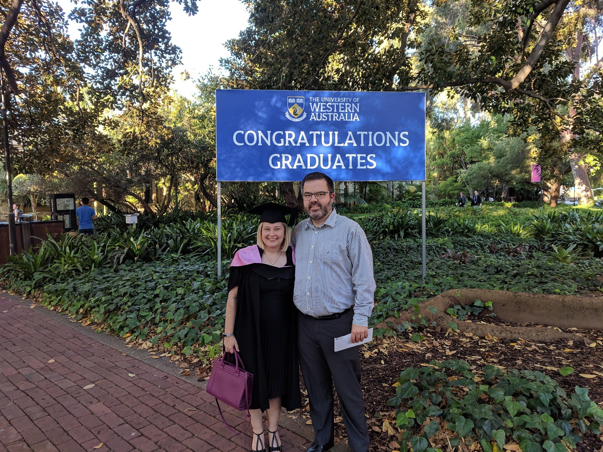
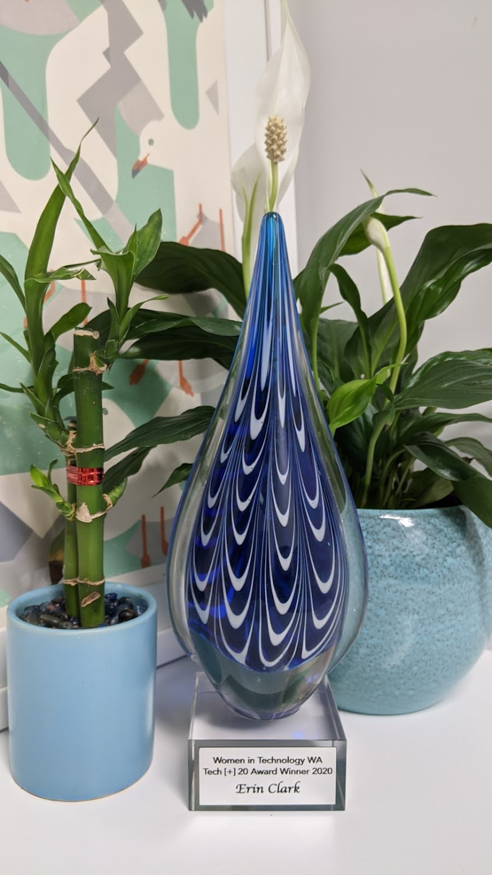
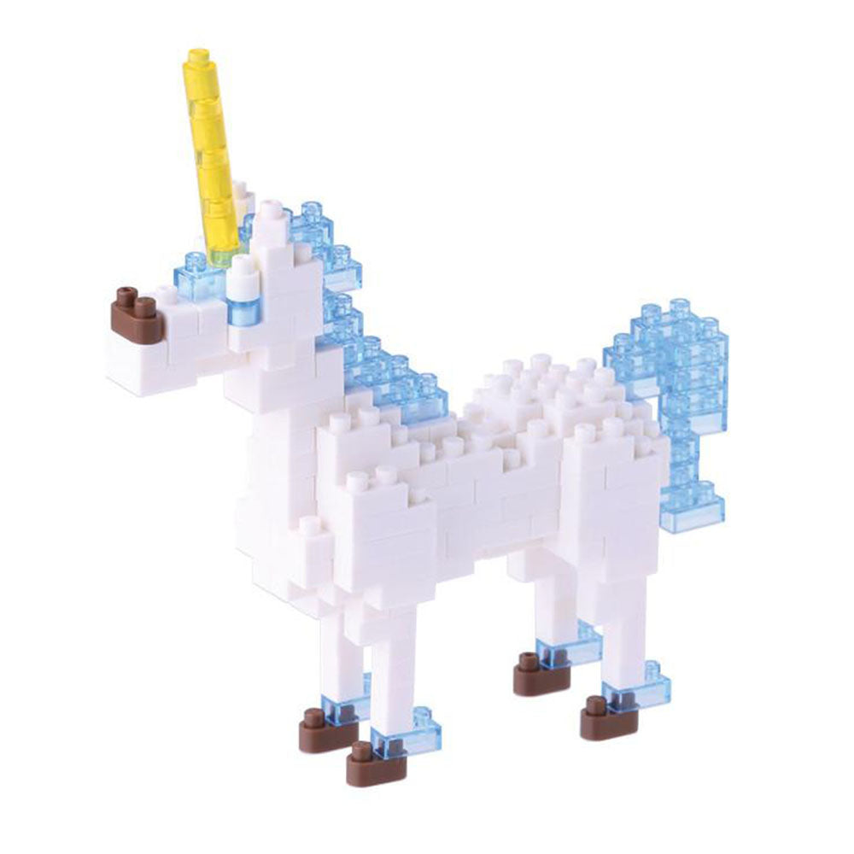
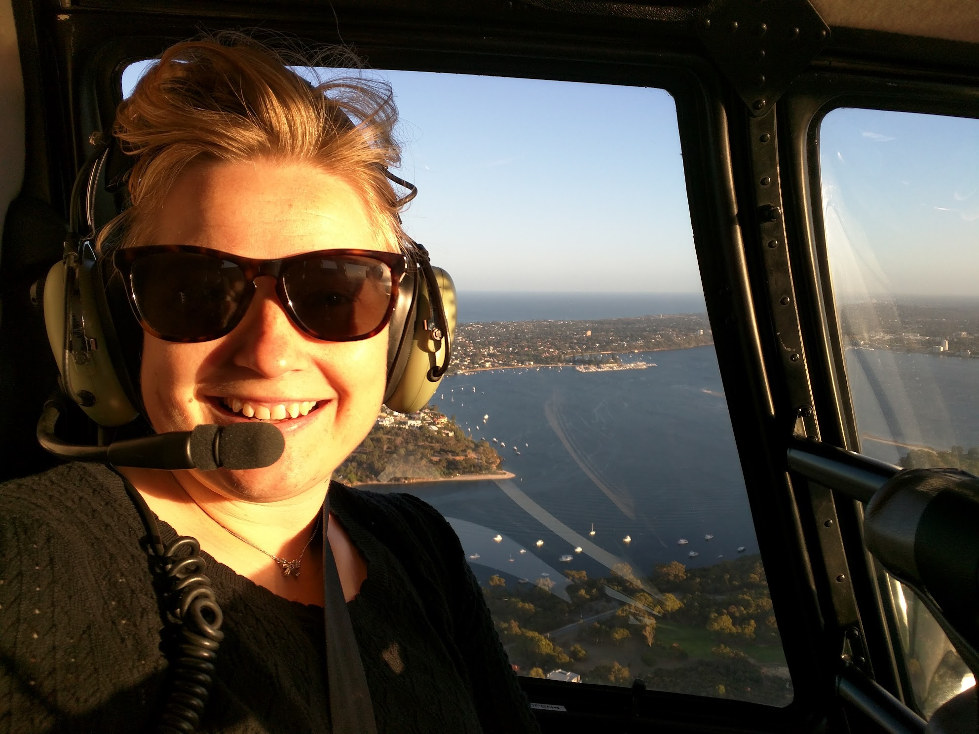
HOW I GOT HERE?

Slide 4

WHAT I DO…
Technology commercialisation

Slide 5
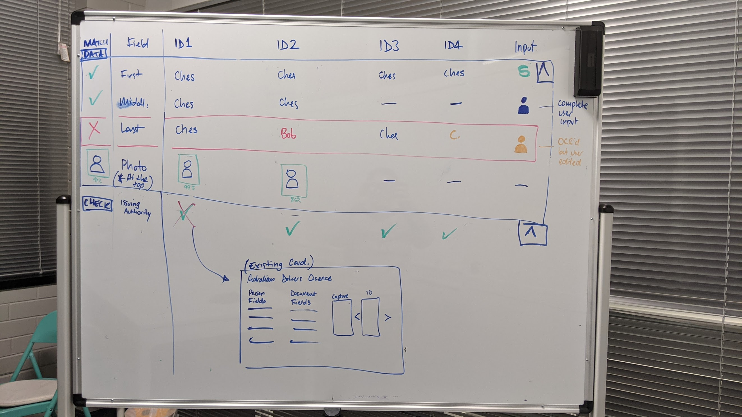
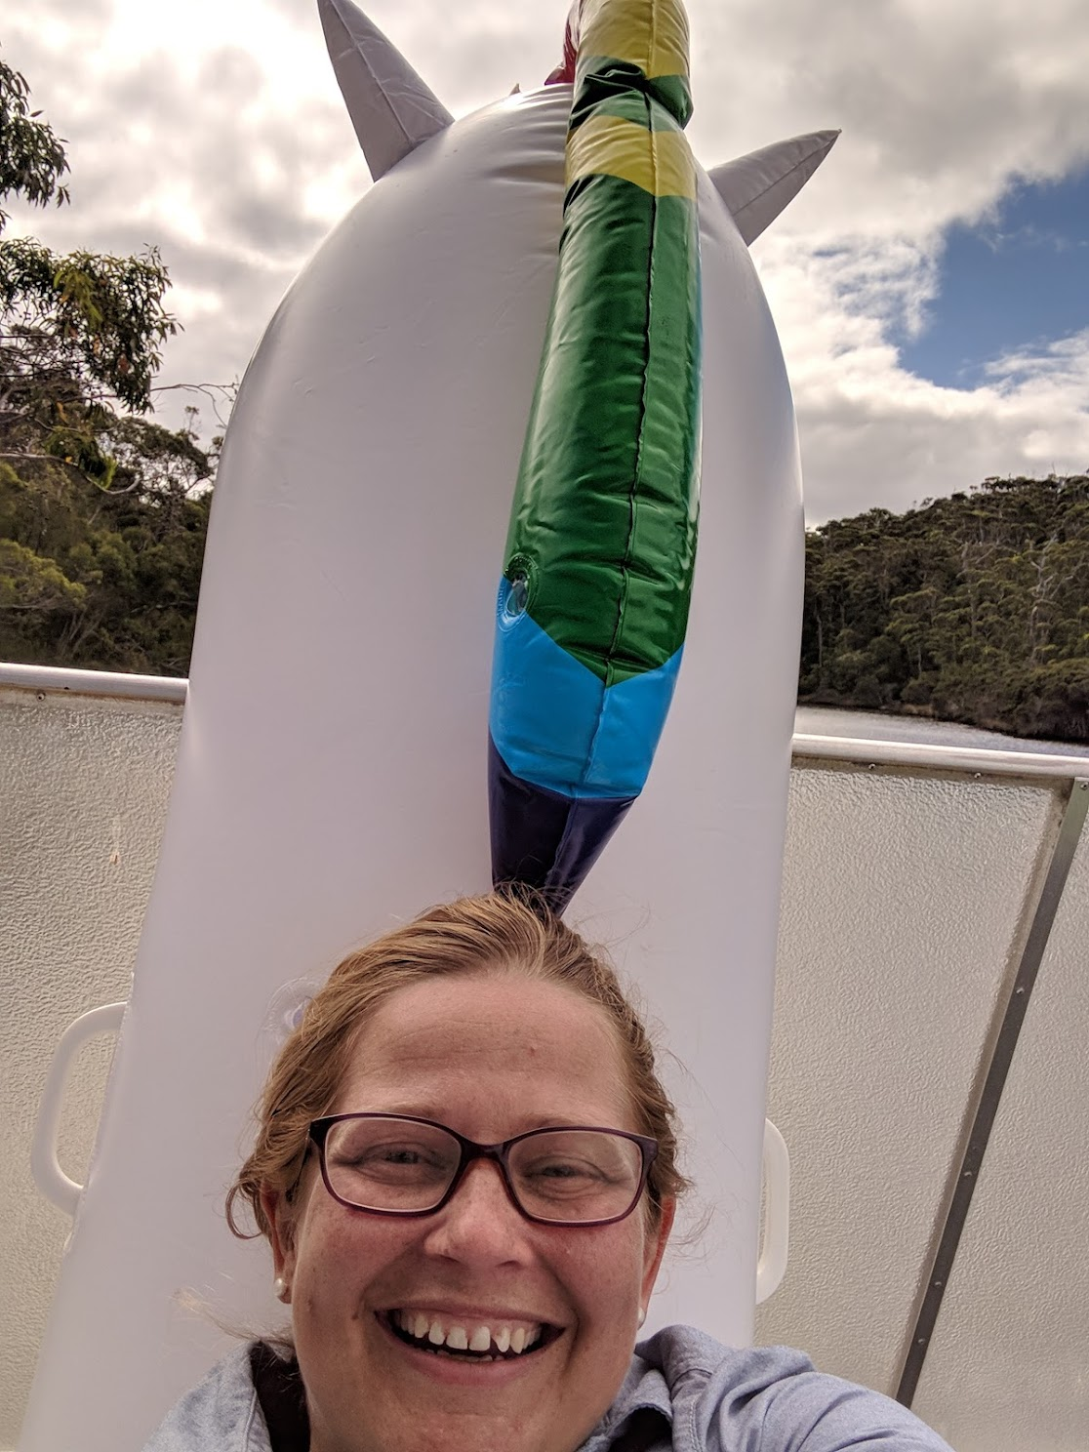
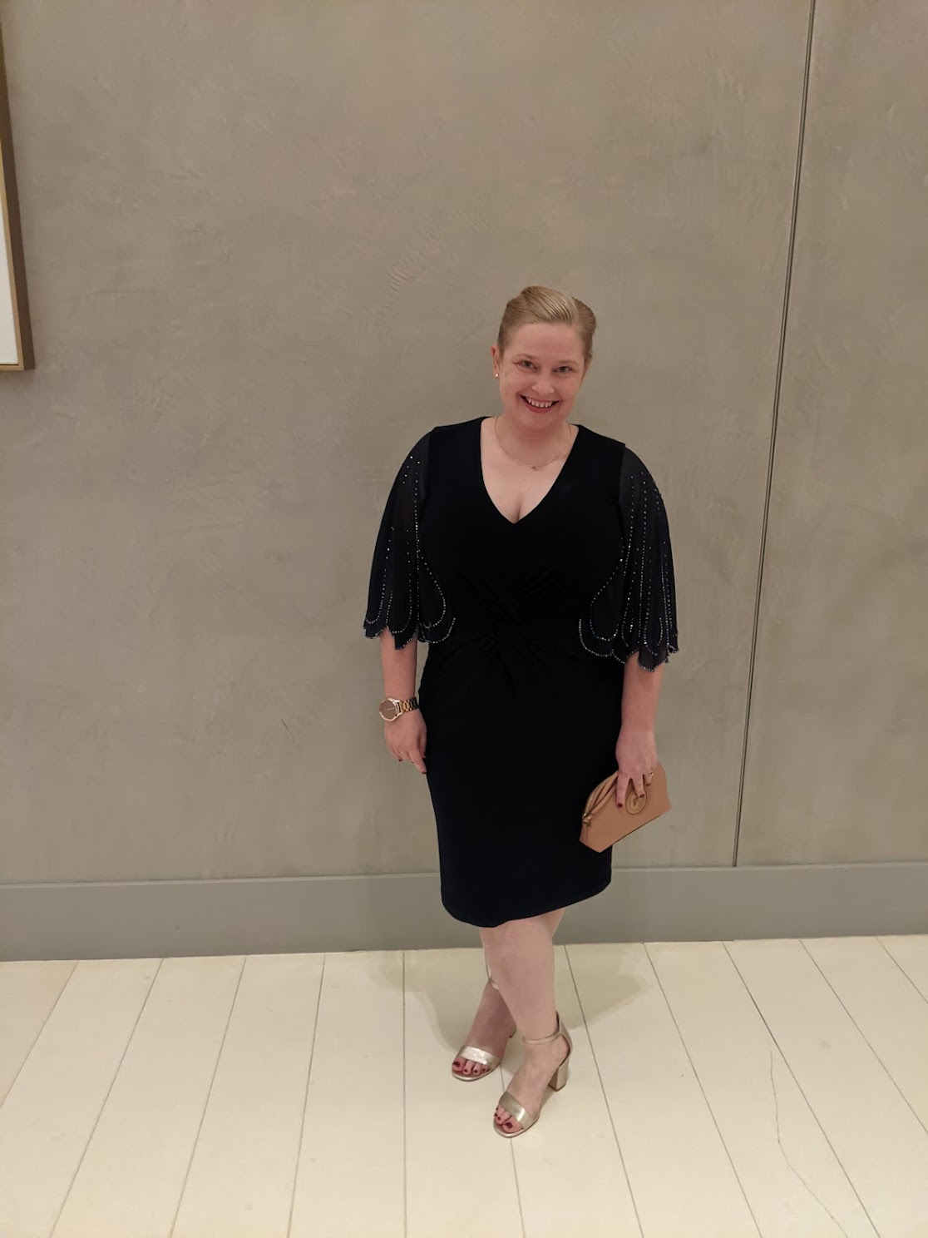
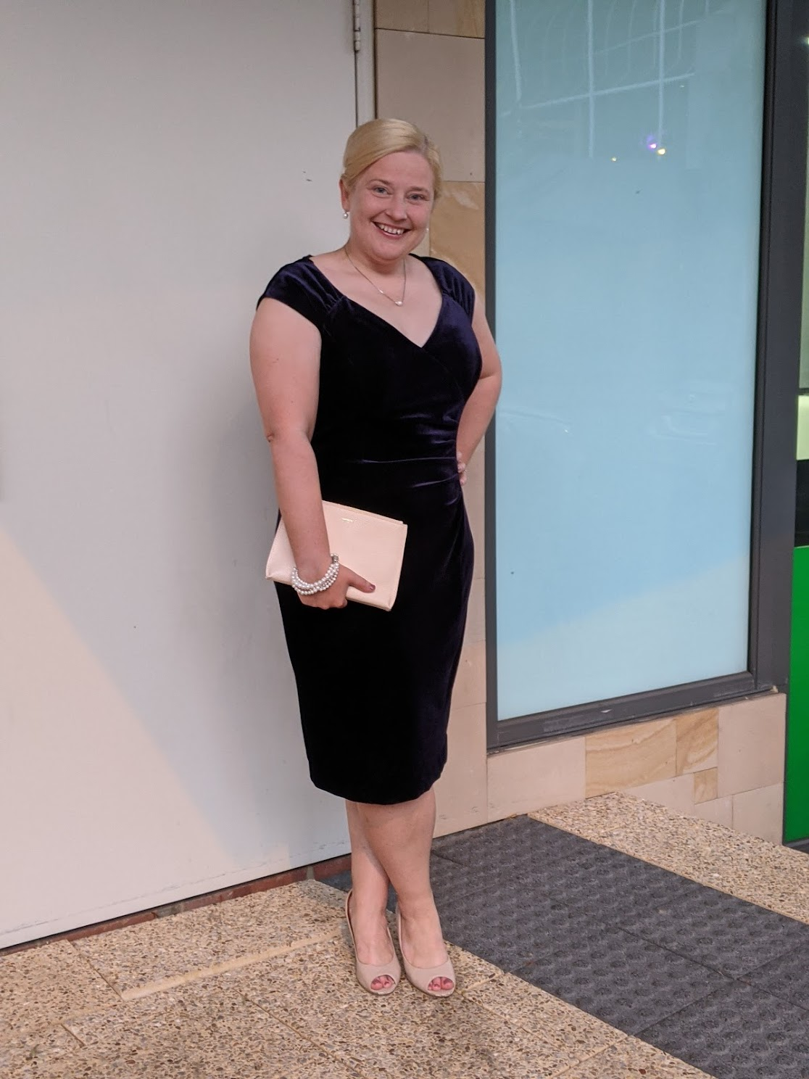
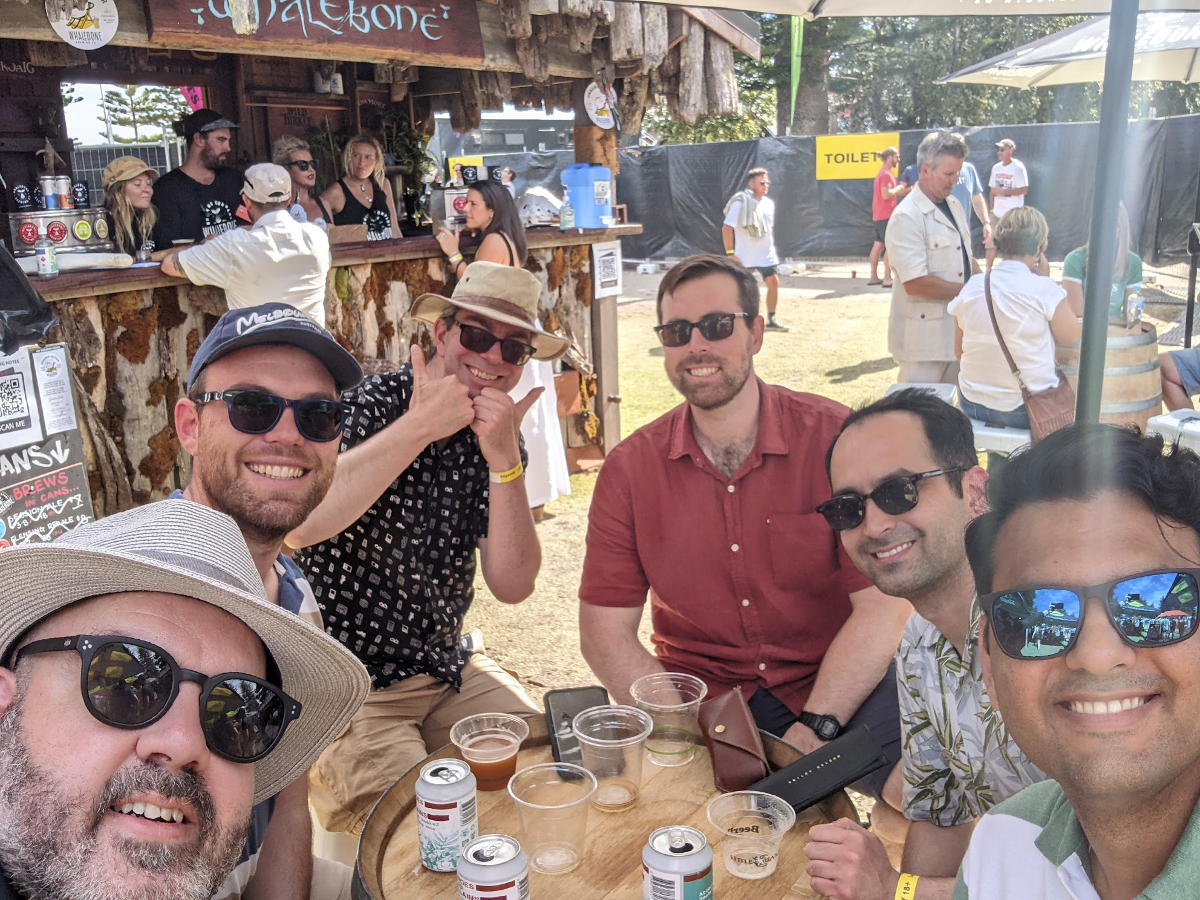
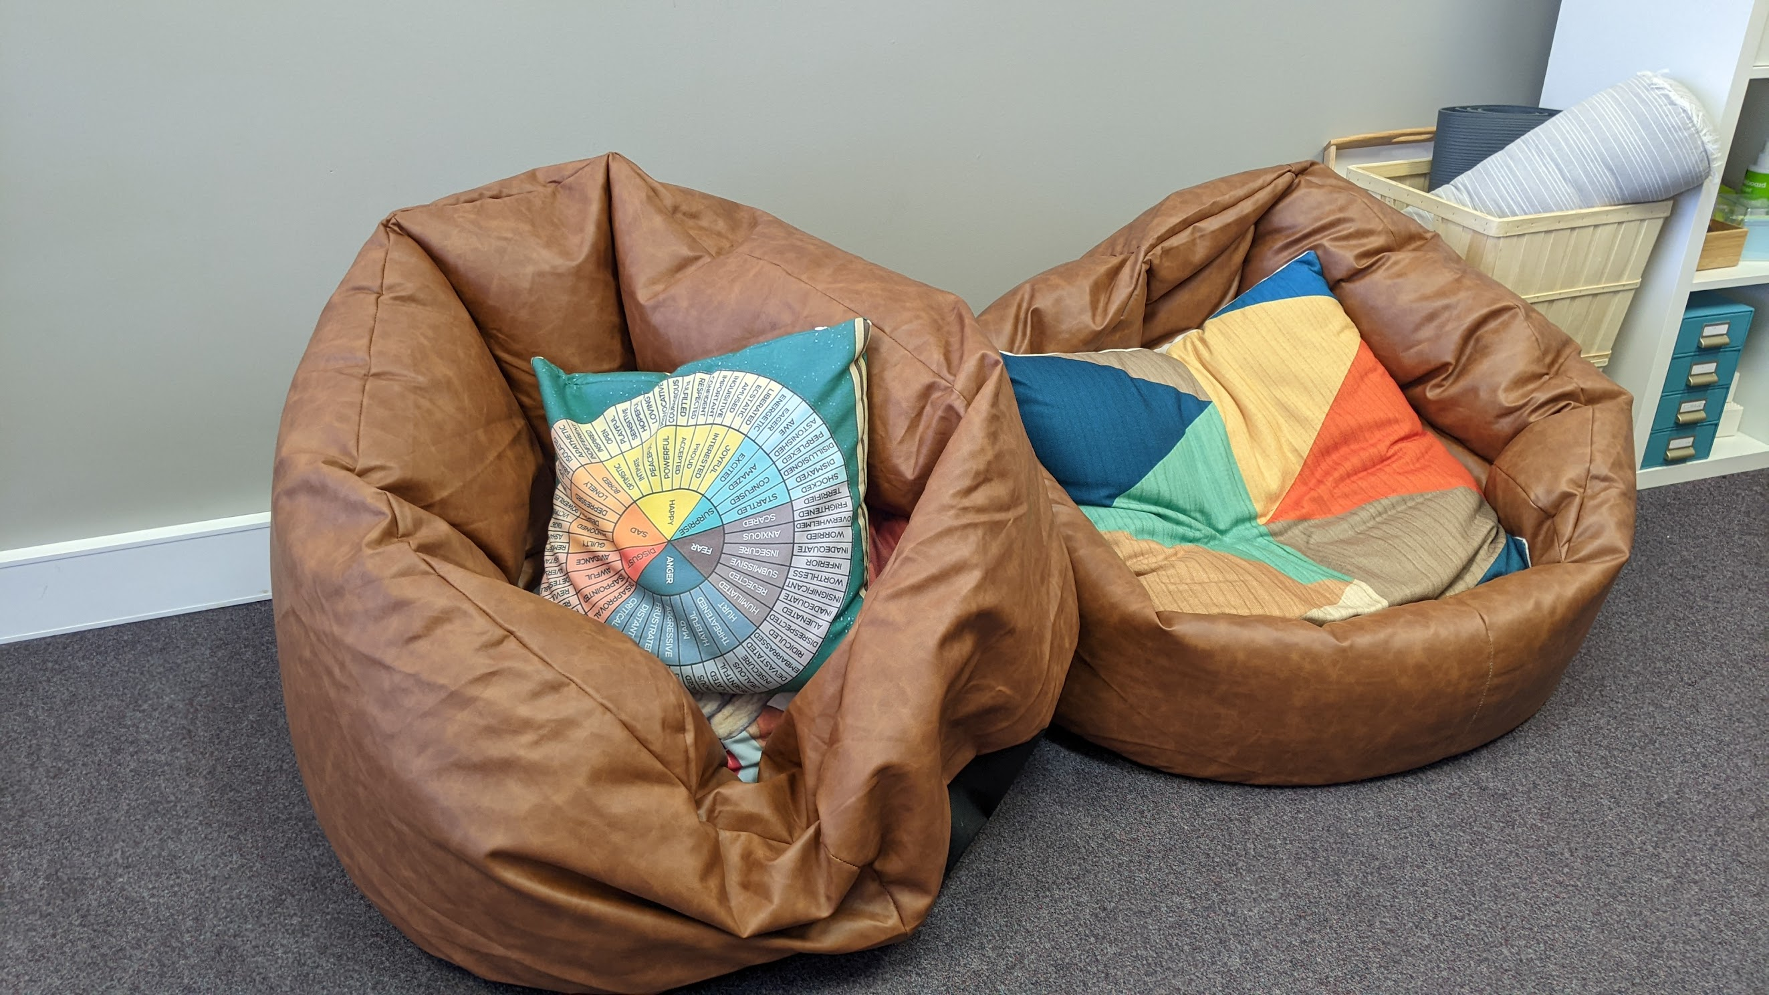
WHAT PEOPLE THINK I DO…
Notes:
Think of the start-up as lots of bean bags and beers and events. It’s nowhere near as glamorous as that!
Yes, I am riding a giant unicorn.
In reality, there are a lot of post its & whiteboards involved.

Slide 6

WHAT I ACTUALLY DO…
Product – What?
Customer – Who?
Market - Why?

Slide 7

HOW DO I IT…
“Lean” Planning
Customer Exp.
Market Analysis & Testing
Experiment with price, place, process, promotion & position
User-centric journeys that create raving fans
“Good enough” products & internal processes
User Exp.
UI
Notes:
That’s all nice but how does it work?
How do you actually find the sweet spot where money comes from the heavens.
User experience is part of a broader journey
User interface even within that.

Slide 8
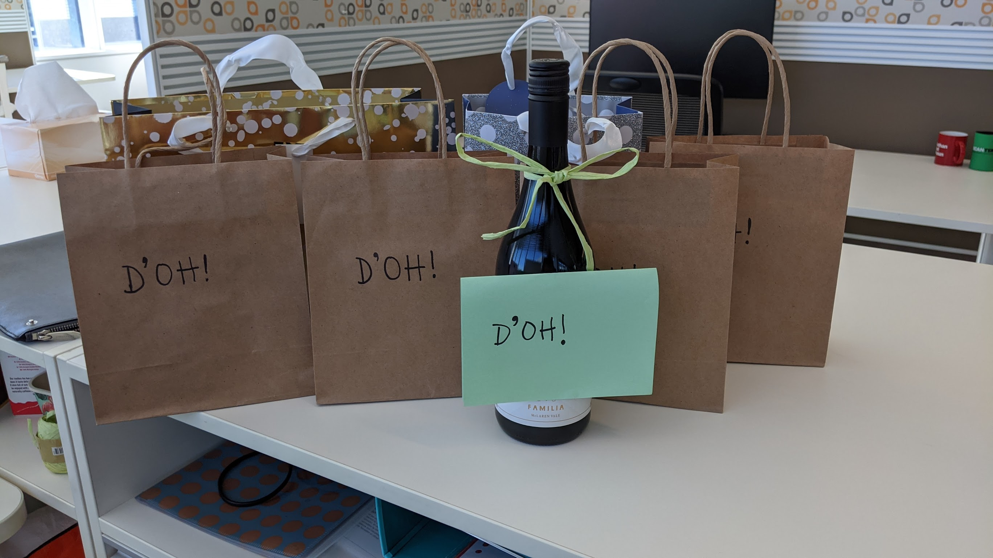
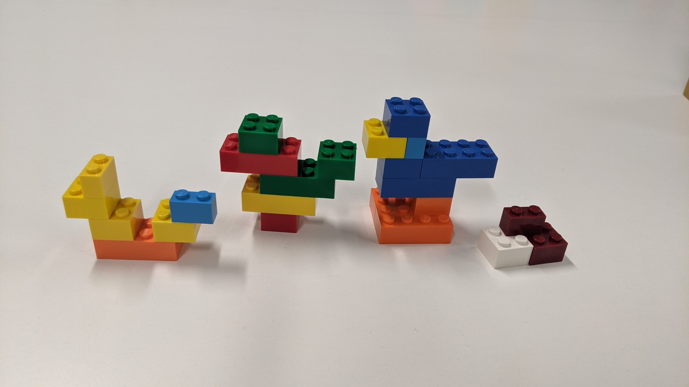
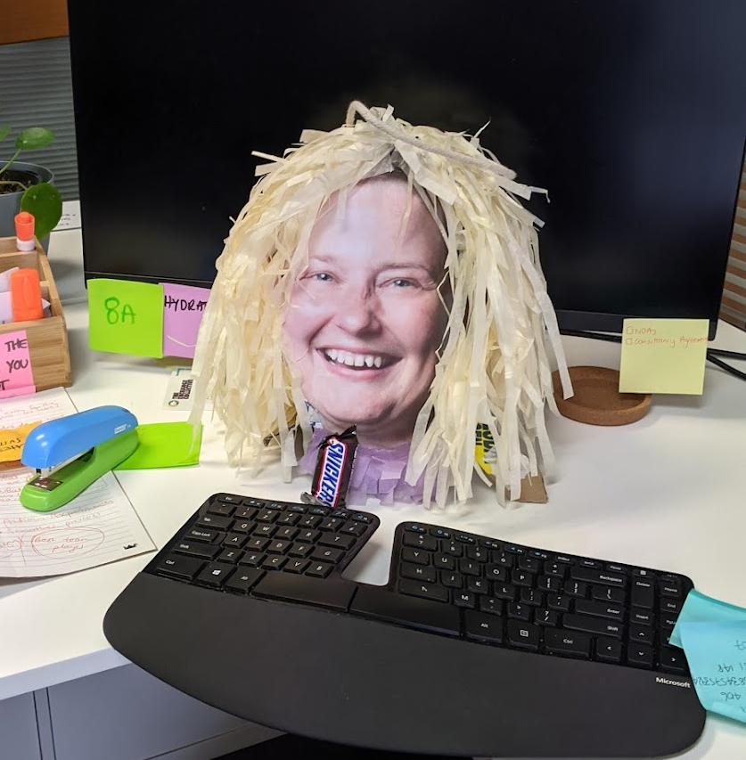
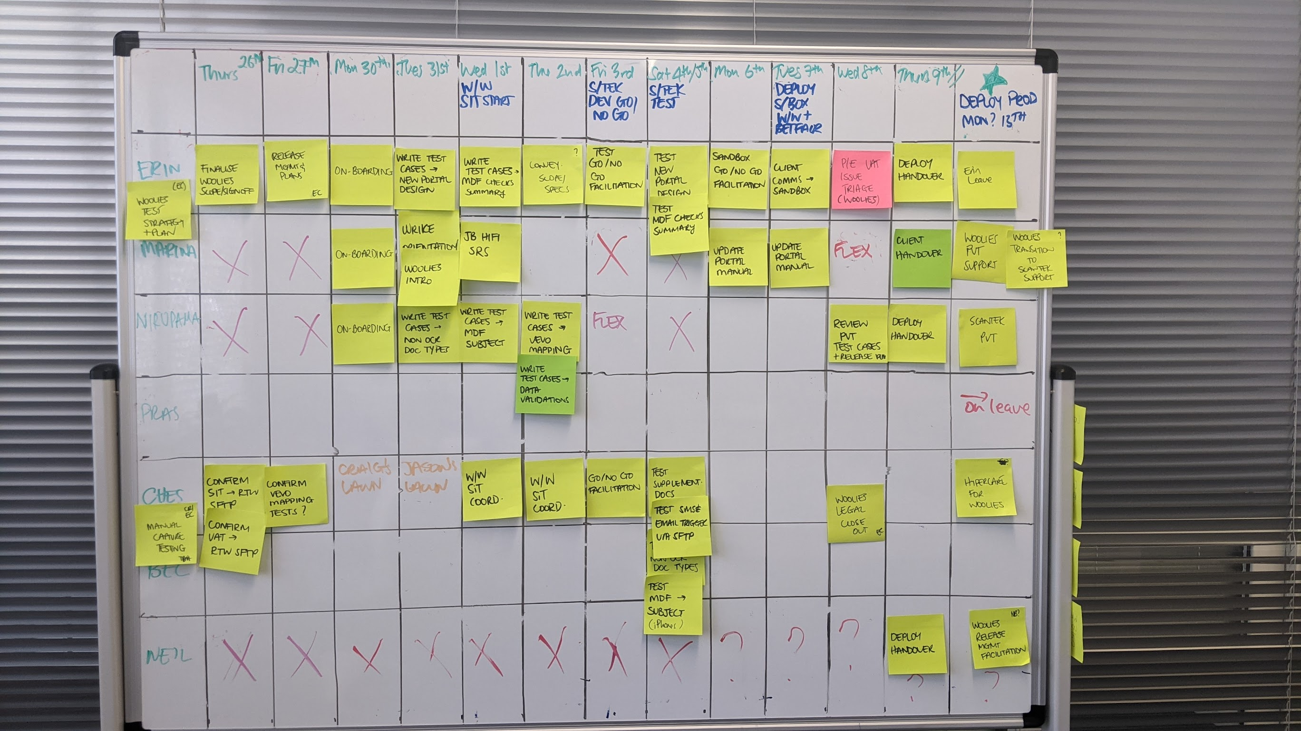
… DIFFERENTLY
Playful
Valued
Trusted
Notes:
Do try to keep things a little playful to drive innovative thinking.
Playful, valued & trusted.
Lesson is that frameworks and techniques you use at uni are great – the challenge is to work out pull out & when. Don’t be afraid to use across industry or subject matter.

Slide 9


Customer experience?
User experience?
User interface design?

Slide 10
CASE STUDY:
Can you launch a new business – and “loveable” product in 25 days?
Notes:
Part bet, could I launch a start-up in less than 30 days
Started with a problem.

Slide 11
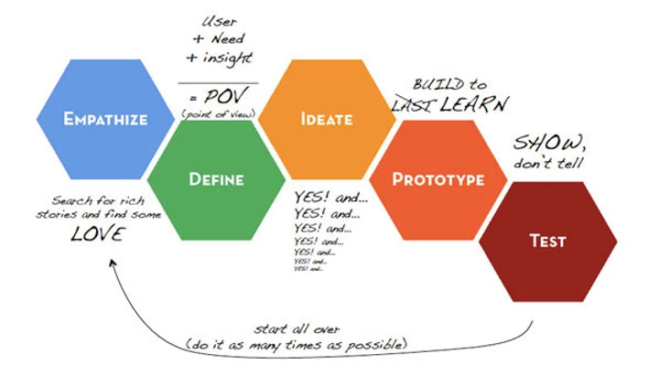
Design thinking?

Slide 12
Key Questions: Day 0
Isn’t this walking tour app terrible?
Why are those walking tours always busy?
Isn’t it about time you did your own start-up?
How do you know what is still open in the City?
Notes:
Do try to keep things a little playful to drive innovative thinking.
Playful, valued & trusted.
Lesson is that frameworks and techniques you use at uni are great – the challenge is to work out pull out & when. Don’t be afraid to use across industry or subject matter.

Slide 13
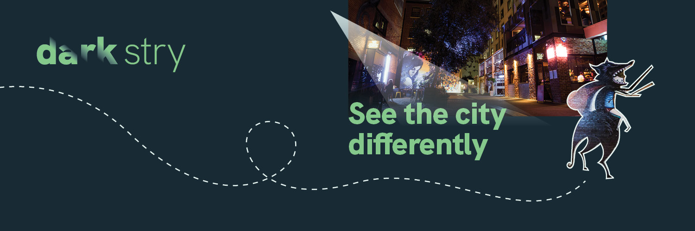

Capability Statement

Slide 14

Let’s explore the dark
Discover a hidden world
The city is a hub of activity with an often overlooked history filled with amazing stories.
Dark Stry takes you on a self-guided journey through your city, to discover the hidden world beneath. With food and beverage locations along the way, it’s the best way to spend time in the city.

Slide 15
Getting started questions?

Slide 16
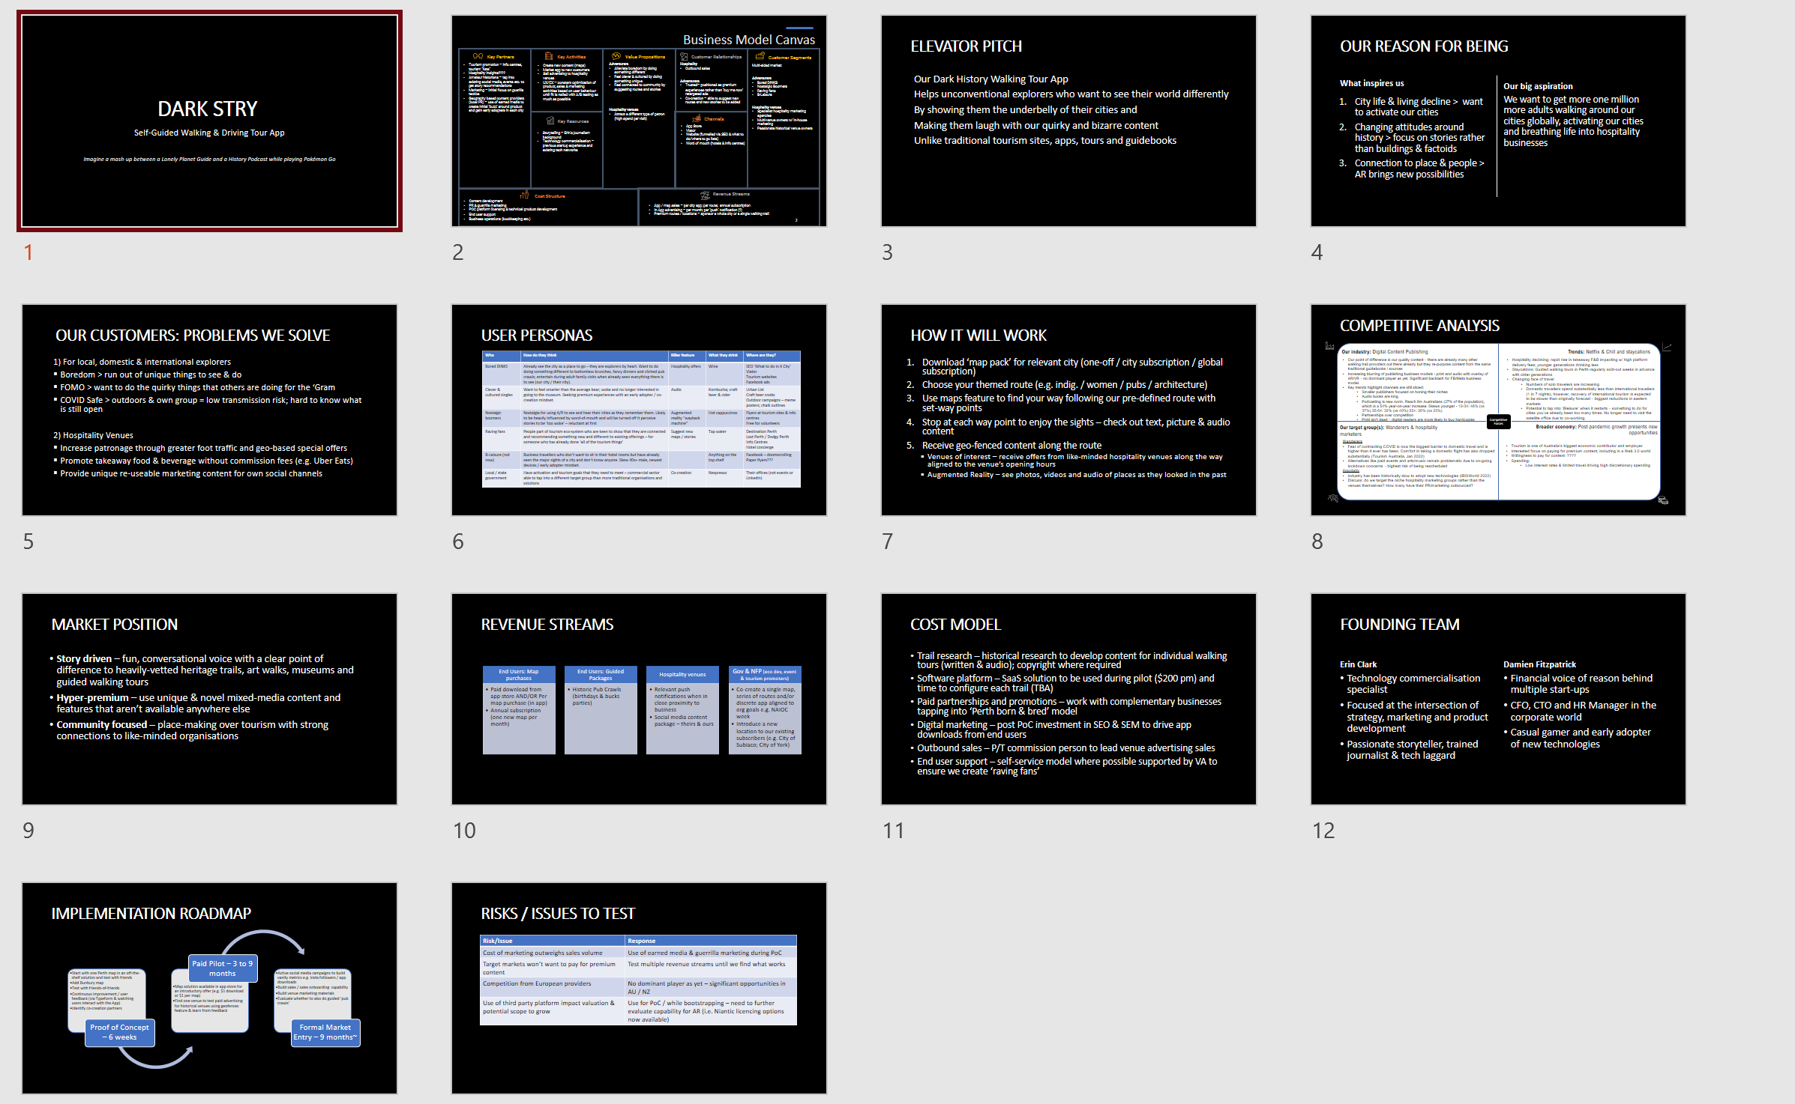
Scoping: Day 1
The important bits:
Problem definition
Competitive Analysis
User Personas
Customer journey map
Cost Model
Notes:
Problem definition – bit that is so often missed. Problem that we are solving is boredom & FOMO.
Competitive Analysis – uses Porters competitive forces. We realised through this exercise that we were actually creating a publishing business rather than a travel business.

Slide 17
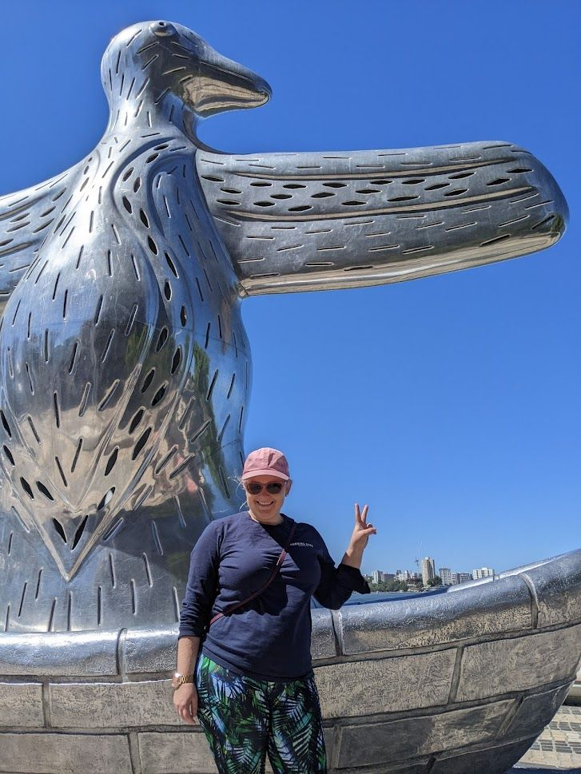
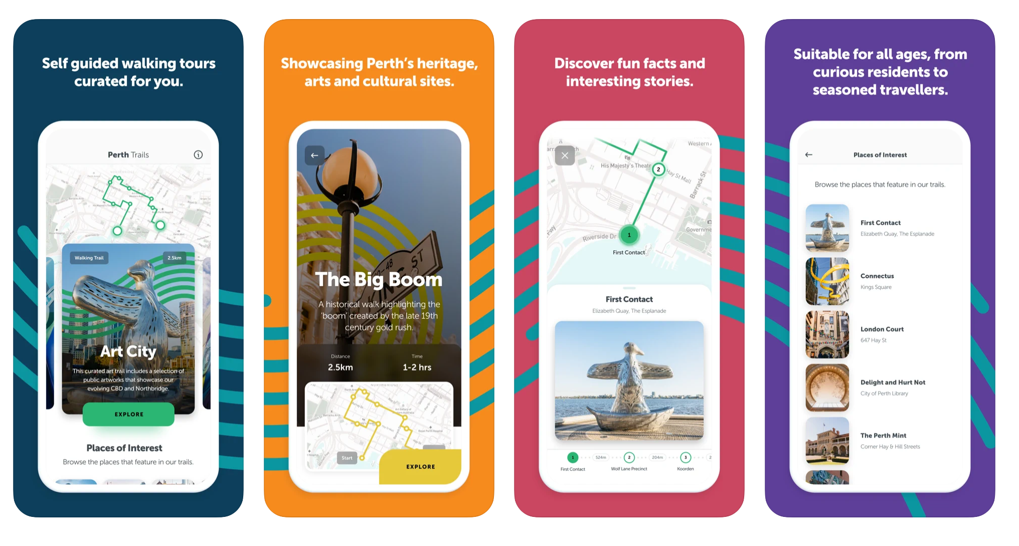
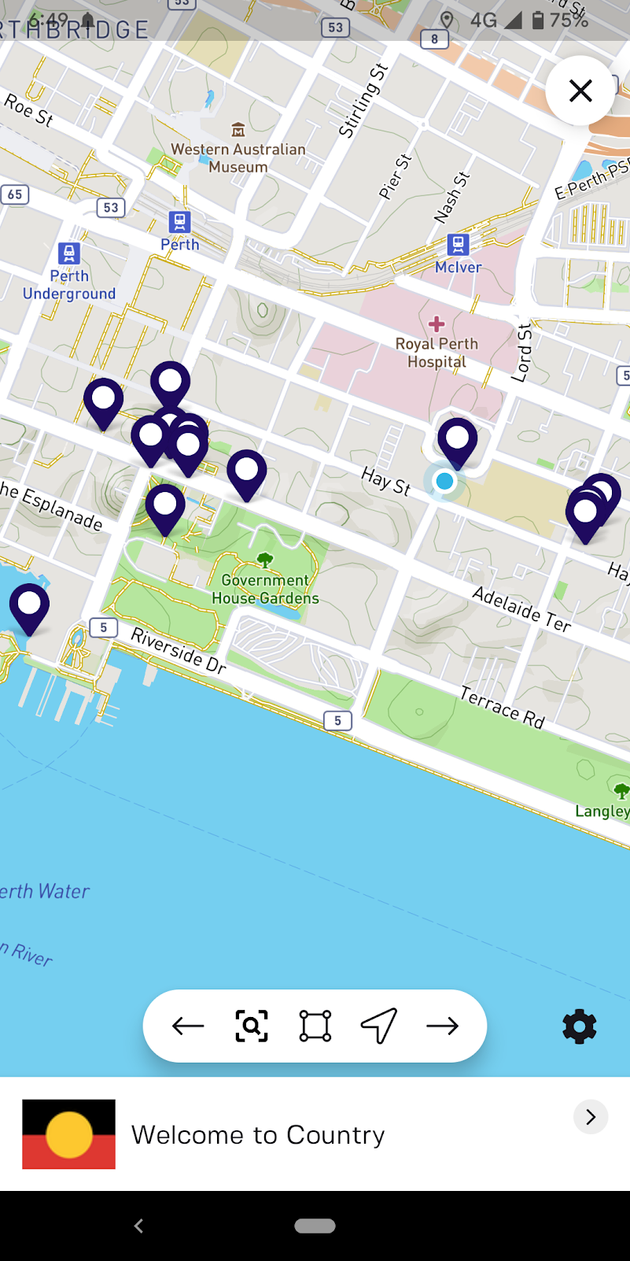
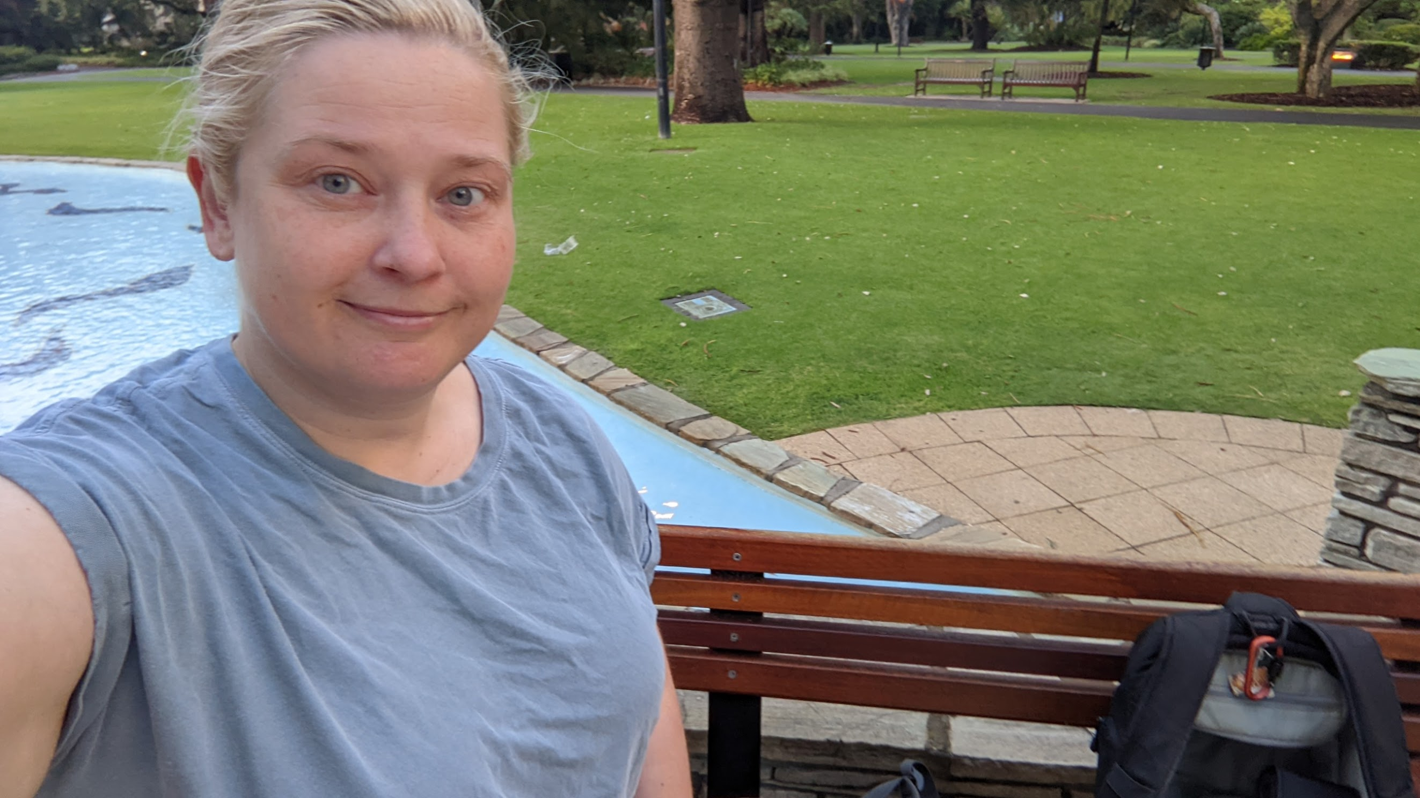
UX Research: Day 2 - 4
Notes:
Downloaded a mountain of different apps using different platforms
Walked around with the ones that were based in Perth to see what we liked & didn’t like

Slide 18
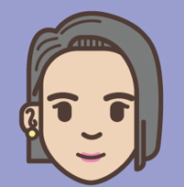
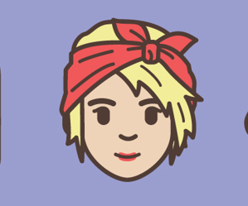

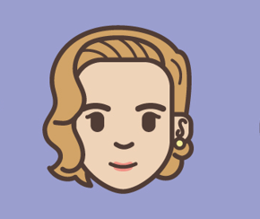


Persona Deep Dive: Day 5
Bored DINKS
Clever & cultured singles
Raving Fans
B-Leisure
House wine
Top-shelf whisky
Wine by the bottle
Craft beer & cocktails
Boozy Boomers
Mid-tier wine & beer
Notes:
Do try to keep things a little playful to drive innovative thinking.
Playful, valued & trusted.
Lesson is that frameworks and techniques you use at uni are great – the challenge is to work out pull out & when. Don’t be afraid to use across industry or subject matter.

Slide 19
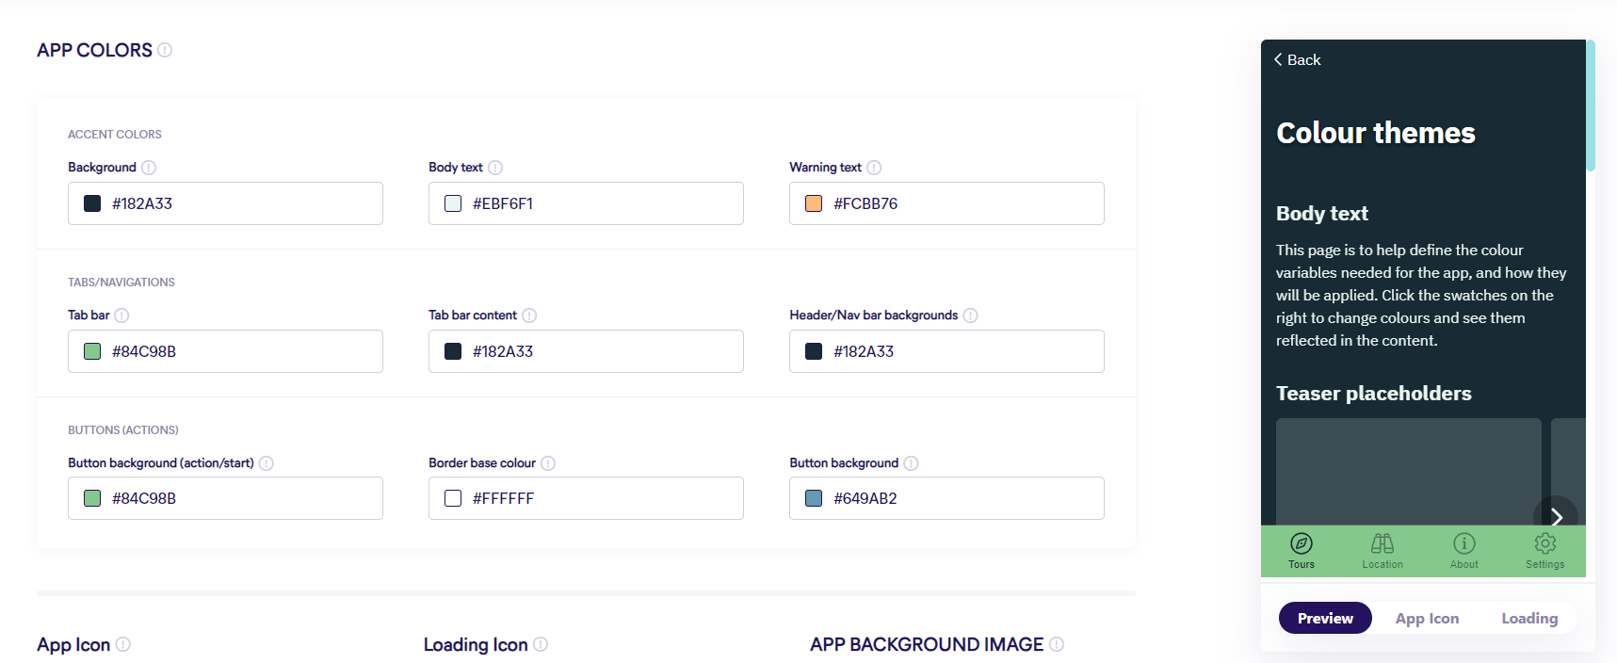
UI Constraints: Day 6
Notes:
So we didn’t do detailed wireframes as we’re using codeless software

Slide 20
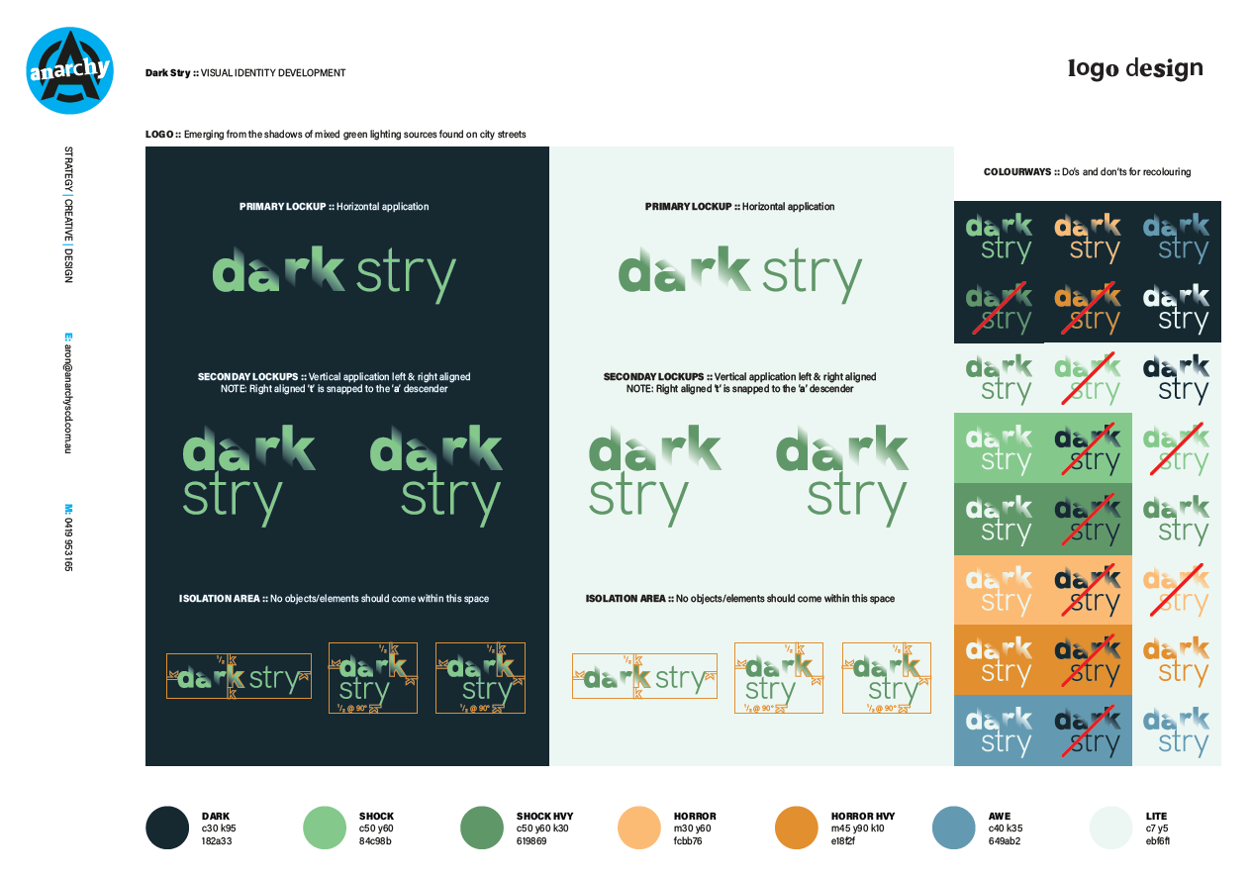
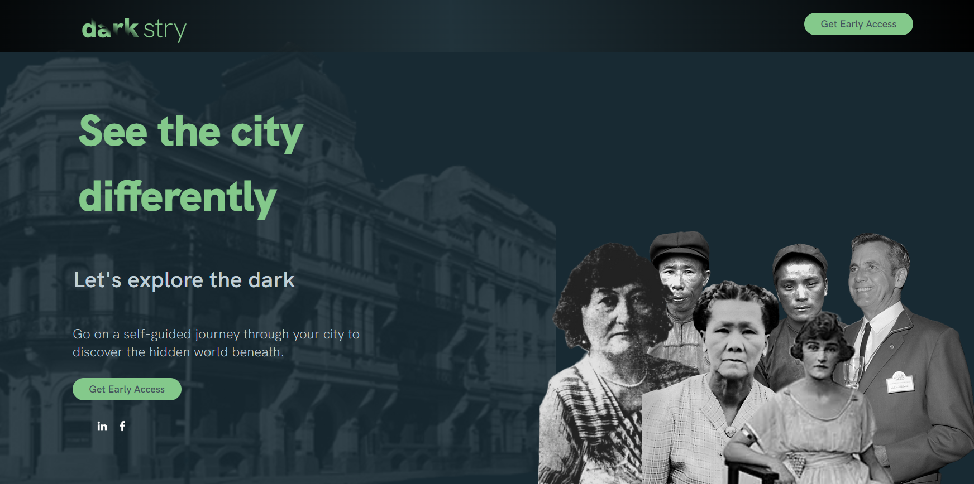
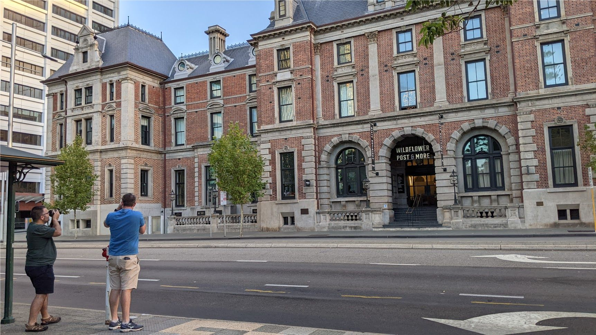
Design: Day 7-9

Slide 21
Configure PoC: Day 7-18
Plan across devices
Get the right colour palette & sizes
Test, test, test user journey
Start small
Lessons learned

Slide 22
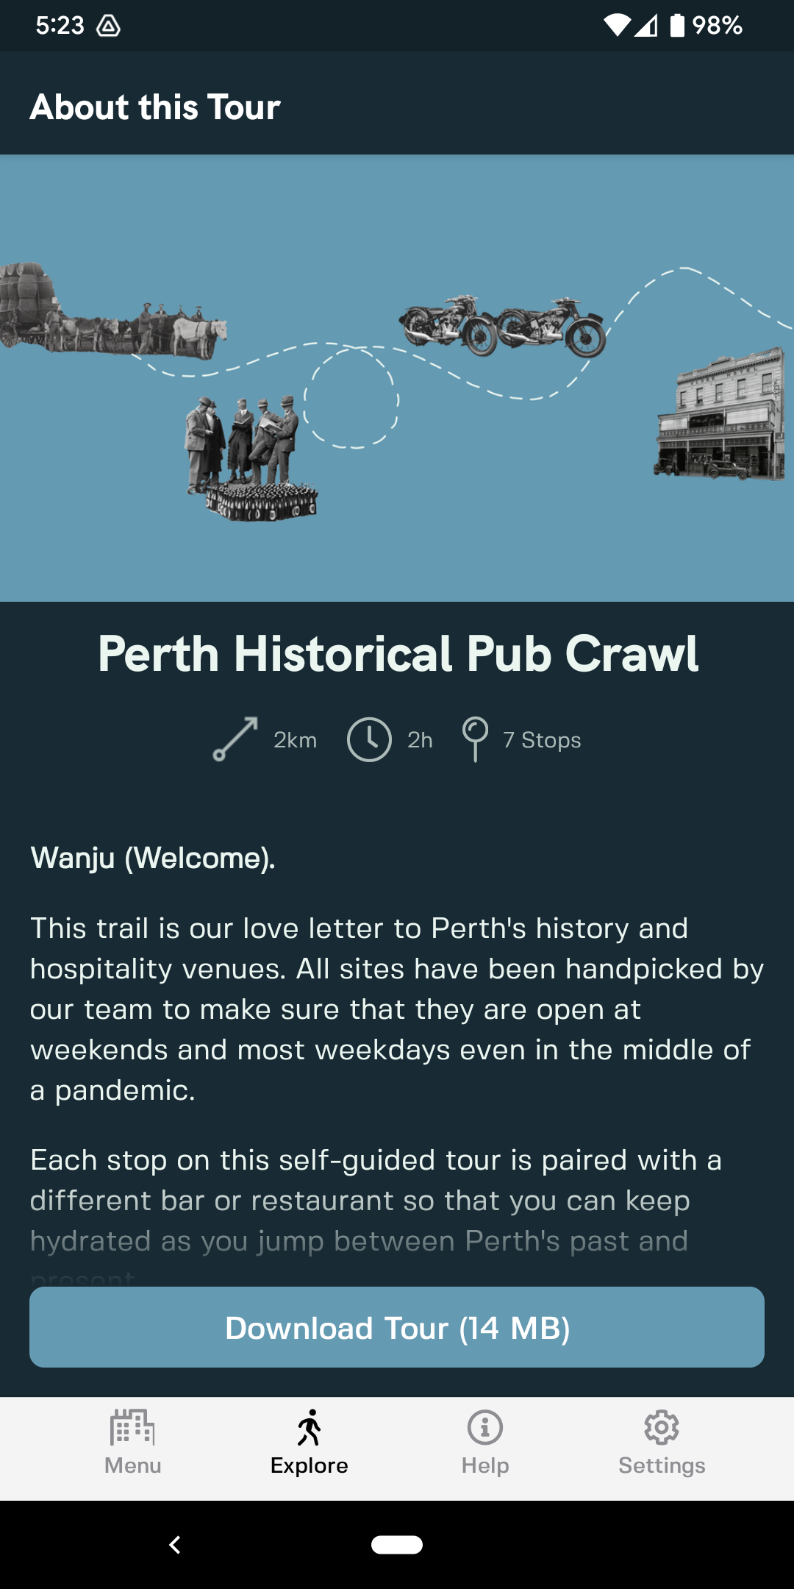
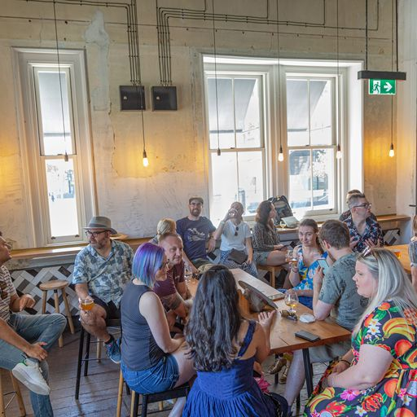
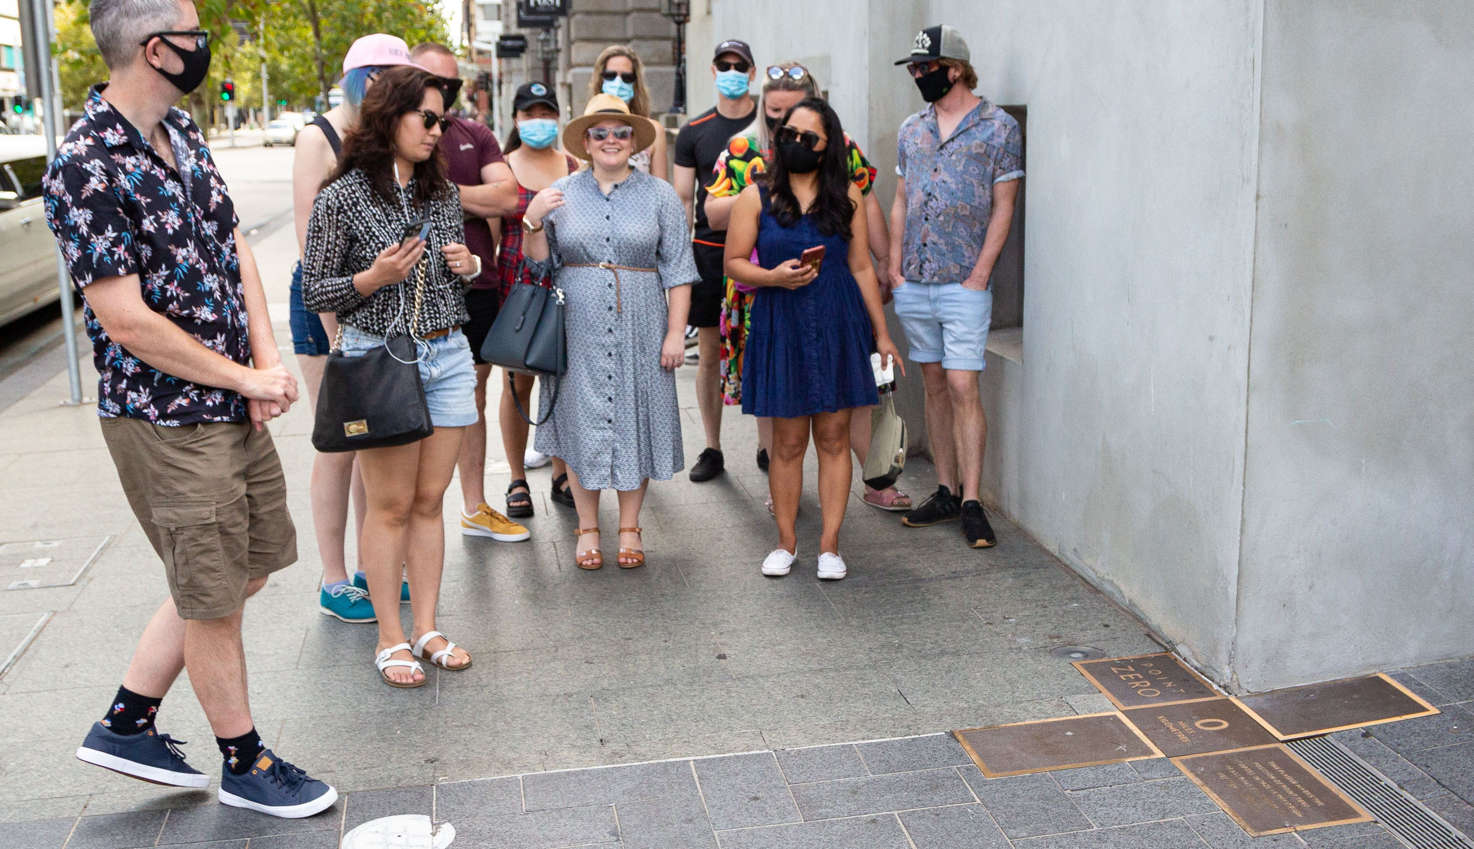
Beta testing: Day 19

Slide 23
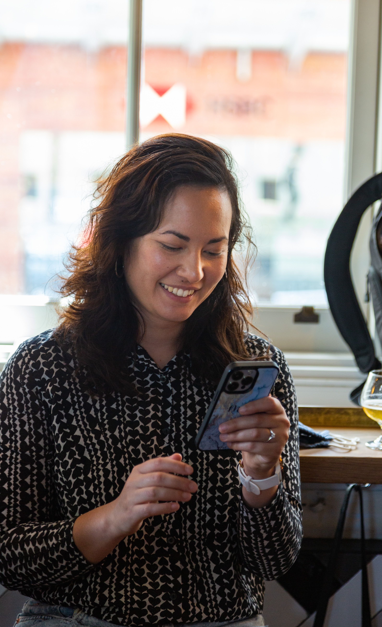
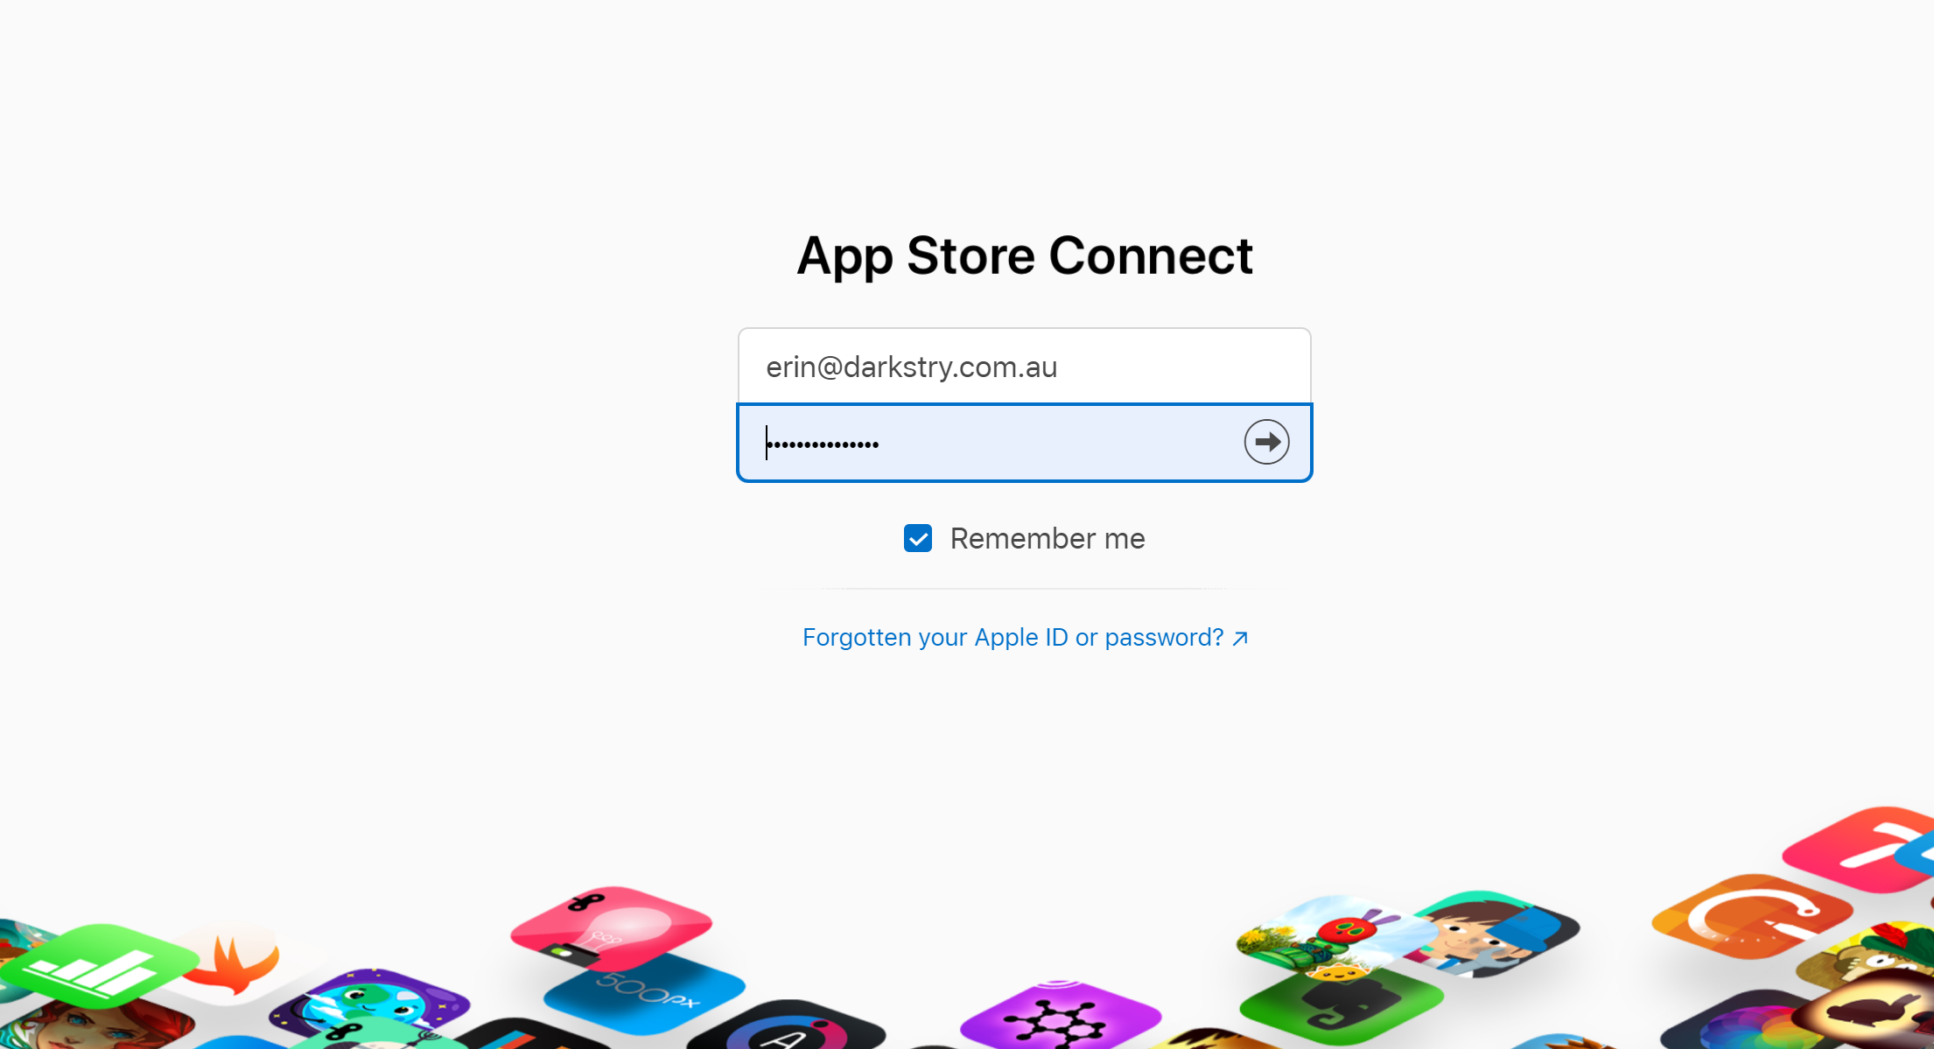
App store: Day 24?

Slide 24






Collaborate early & often
Women-led founder network
Hospitality venue partner
Digital Agency
Virtual & augmented reality specialists
Hospitality venue partner
Opportunities & grant requirements

Slide 25
Planning questions?

Slide 26
CASE STUDY:
“Real world” user experience feedback
Notes:
Part bet, could I launch a start-up in less than 30 days
Started with a problem.

Slide 27
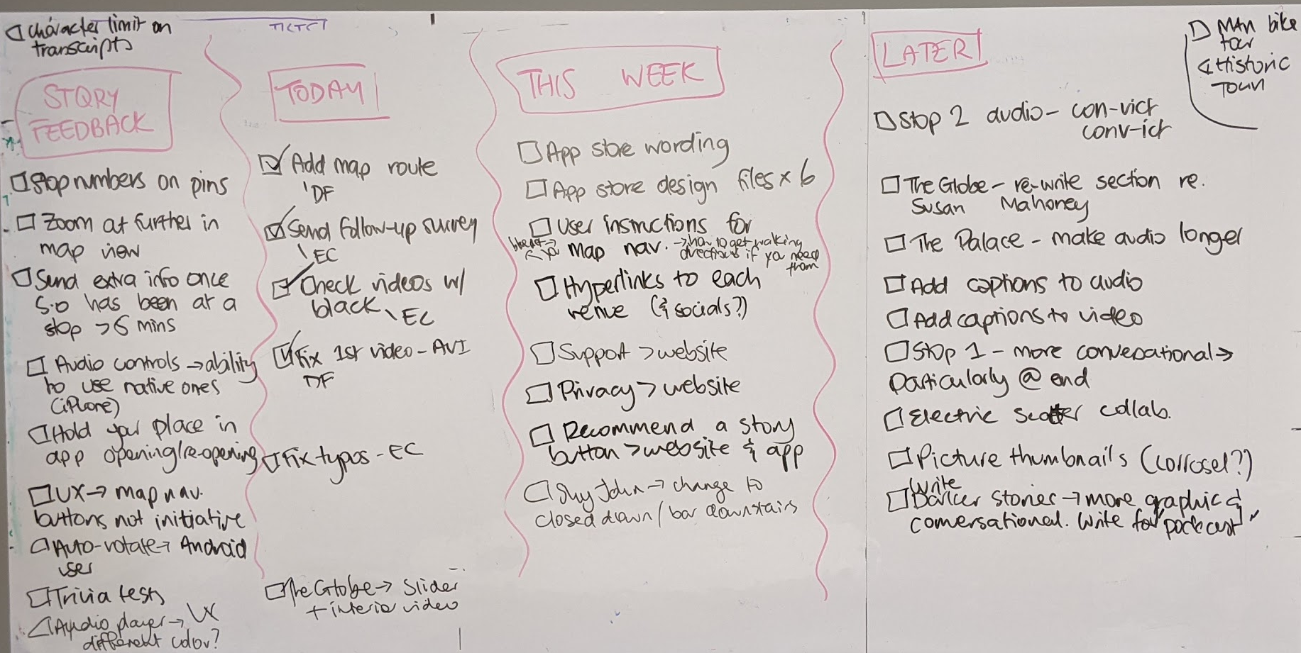
MVP: Prioritise what to do
Minimum Viable Product or Minimum Lovable Product?

Slide 28
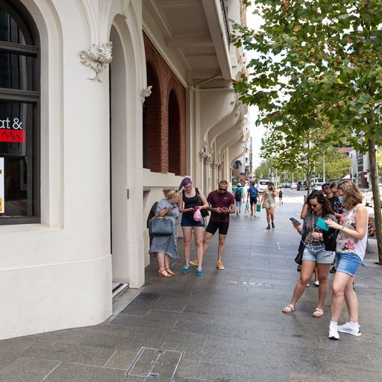
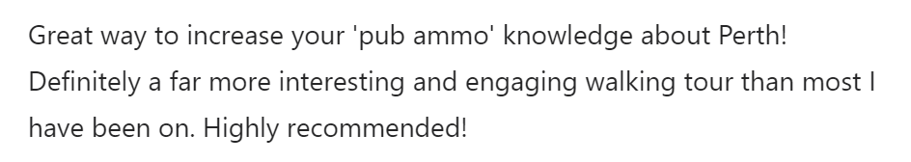
CX: Customer intimacy bridges the gap

Slide 29
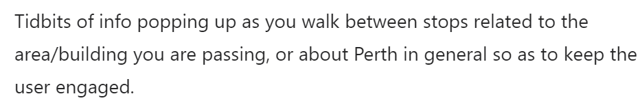
There needs to be more murders and dodgy stuff!
UX: Deliver what you say you will

Slide 30
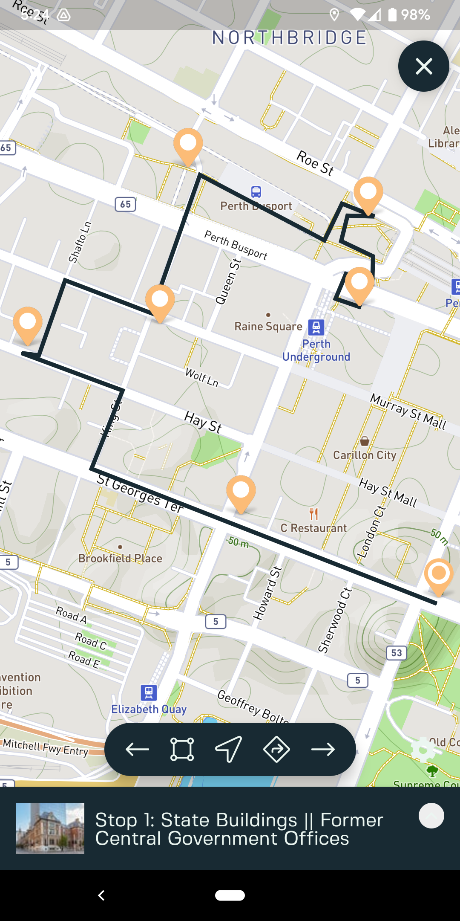
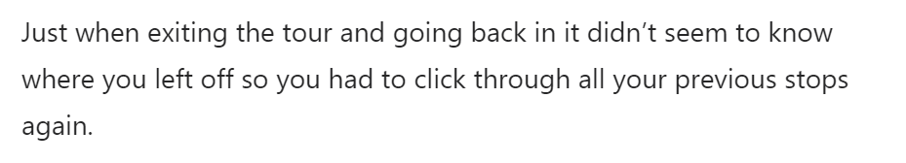
UI:
Make it easy & obvious

Slide 31
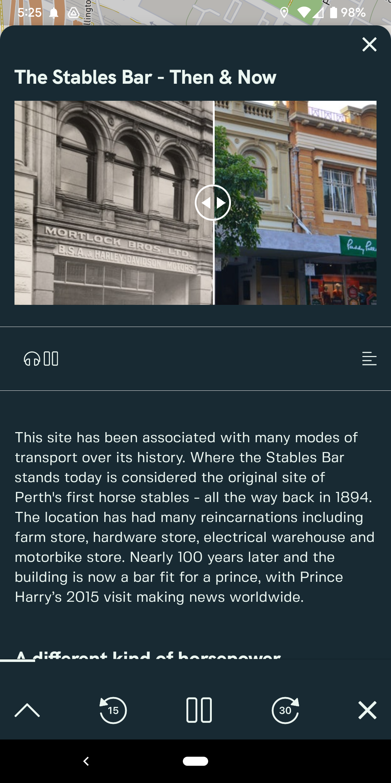
UI: Make it clear what can be clicked

Slide 32
“Real world” questions?

Slide 33

KEY LESSONS
Time-box everything (sprints!)
Test with users early and often – don’t wait for a final product
Do desktop research – but test in the real world
Prioritise user experience over fancy features
Keep it playful!
Notes:
I spend a far bit of time talking with start ups and there’s a lot of people in the room that do too
Who is familiar with this statement?
To burst the bubble for those new to the start up space - getting from start up to scale up and beyond is going to take more than a good CTO and an angel investor
So, my first piece of advice for anyone in the room just getting starting is to start with your tribe first.
But keep in mind that tribes come in many different shapes and sizes
Anyone who knows me knows that I love a rant about the importance of having a diverse tribe. The stats speak diversity and innovation speak for themselves.

Slide 34


KEEP CONNECTED?
Beta testing: www.darkstry.com.au
Follow us on FB & Insta: Darkstrytours
Me: erclark
Dark Stry: https://www.linkedin.com/company/dark-stry
TEC: https://www.linkedin.com/company/the-exchange-collective
Notes:
I spend a far bit of time talking with start ups and there’s a lot of people in the room that do too
Who is familiar with this statement?
To burst the bubble for those new to the start up space - getting from start up to scale up and beyond is going to take more than a good CTO and an angel investor
So, my first piece of advice for anyone in the room just getting starting is to start with your tribe first.
But keep in mind that tribes come in many different shapes and sizes
Anyone who knows me knows that I love a rant about the importance of having a diverse tribe. The stats speak diversity and innovation speak for themselves.

